Slide 1
Global Earthquake Visualization
By - Siddharth Munagala (02197077)
Rohit SHIRKE (02186822)

Slide 2

Introduction
Earthquakes are among the most devastating and unpredictable natural disasters, causing widespread destruction, loss of life, and economic impact.
Understanding seismic patterns through historical data is essential for improving disaster preparedness, risk assessment, and public safety.
Raw earthquake data is often vast and complex, making it difficult to extract meaningful insights without proper tools.
Data visualization transforms this complexity into clear, interactive visuals, enabling easier exploration of trends, hotspots, and the severity of seismic activities.
This project leverages modern visualization technologies to make global earthquake data accessible, informative, and actionable for researchers, policymakers, and the public.

Slide 3
Project Objective
Build an interactive web dashboard to simplify the exploration of global earthquake data.
Visualize earthquakes dynamically by year, magnitude, and geographic location.
Leverage modern web technologies (Leaflet.js, Chart.js, D3.js) for engaging and responsive user interaction.
Provide an intuitive platform to support data-driven decision-making in disaster risk assessment and public awareness.

Slide 4
Significance of the Project
Leverage historical earthquake data (1900–present) to uncover long-term seismic patterns and trends.
Accurately identify global seismic hotspots to enhance awareness of high-risk regions.
Provide valuable insights to aid in disaster risk management, emergency preparedness, and infrastructure planning.
Serve as an educational tool for researchers, policymakers, and the public to better understand the global impact of seismic activities.
Demonstrate how interactive data visualization can simplify complex datasets, enabling informed decision-making and proactive safety measures.

Slide 5
Dataset Overview
Source: This dataset, sourced from Kaggle, offers a comprehensive record of significant global earthquakes (Magnitude 5+).
Period Covered: Comprehensive data spanning from 1900 to present, capturing over twelve decades of global earthquake activity.
Key Features: - Date & Time: For temporal filtering and trend analysis.
- Latitude & Longitude: Epicenter coordinates for mapping.
Magnitude: Indicates earthquake strength.
Depth: Depth of origin in kilometers.
Place: Human-readable location description.
Type: Classification of seismic events (eg.,earthwuake, explosion)
- Magnitude Type: Measurement scale used (eg.,Mw, Mb)

Slide 6
Data pre-processing
Loaded dataset from Kaggle (USGS source) using d3.csv()
Converted key fields (Year, Latitude, Longitude, Magnitude, Depth) to numeric types for accurate mapping and analysis.
Filtered out incomplete records.
Categorized magnitudes into Low, Strong, and Destructive for bar graph visualization.
Scaled magnitude values for effective heatmap intensity representation.
Sorted data to extract the Top 15 strongest earthquakes for the D3.js bubble chart.
Optimized dataset for smooth performance in interactive visualizations.

Slide 7
Technology Stack
Frontend: HTML, CSS, JavaScript — for structuring, styling, and adding interactivity to the dashboard.
Visualization Libraries:
- Leaflet.js — Interactive Maps & Heatmap for spatial earthquake data.
- Chart.js — Bar Graph to categorize earthquake magnitudes.
- D3.js — Dynamic Bubble Chart showcasing top seismic events.
Design Approach:
- Fully Responsive layout for seamless viewing across devices.
- Focused on Interactive Design to enhance user engagement and data exploration.

Slide 8
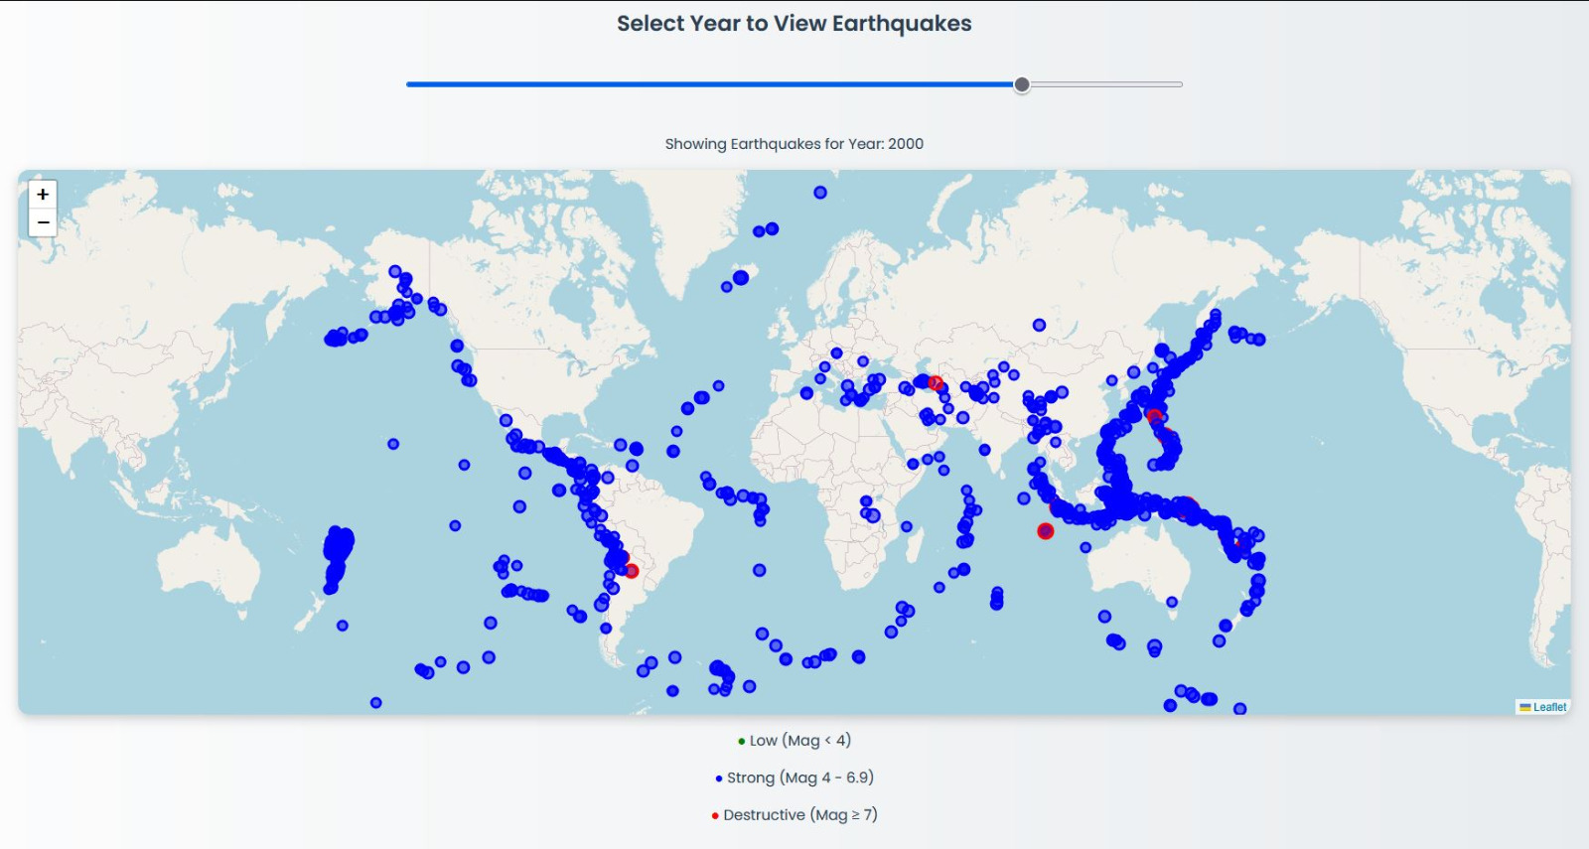
Visualizations: Interactive map
Displays earthquake locations by year, allowing users to explore temporal and geographic patterns of seismic activity interactively.

Slide 9
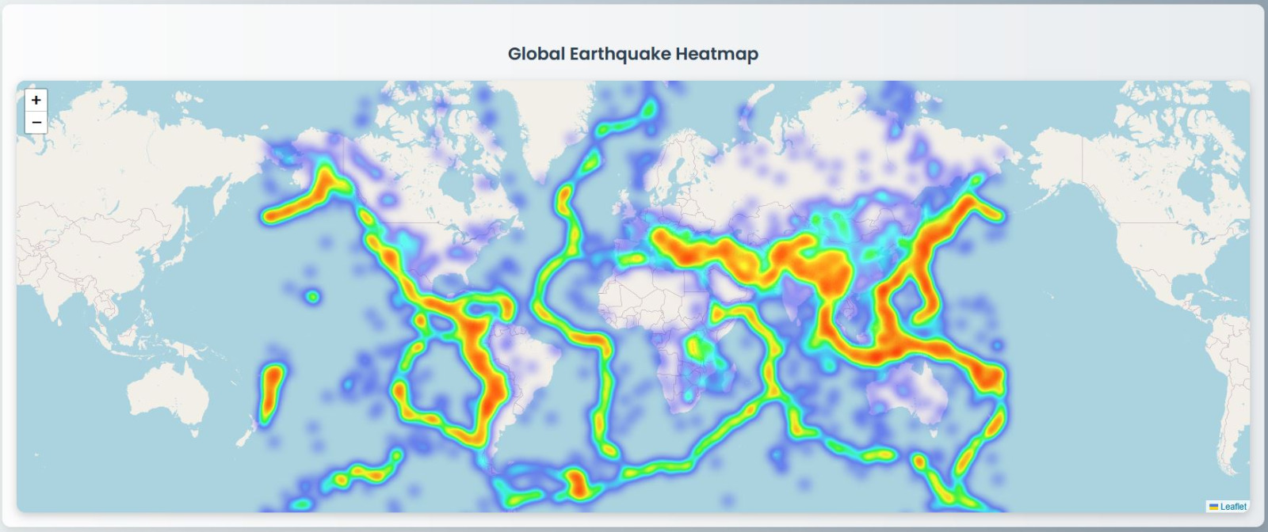
Visualizations: Heatmap showing density
Highlights global seismic hotspots by visualizing earthquake density, making it easy to identify the most active tectonic regions.

Slide 10
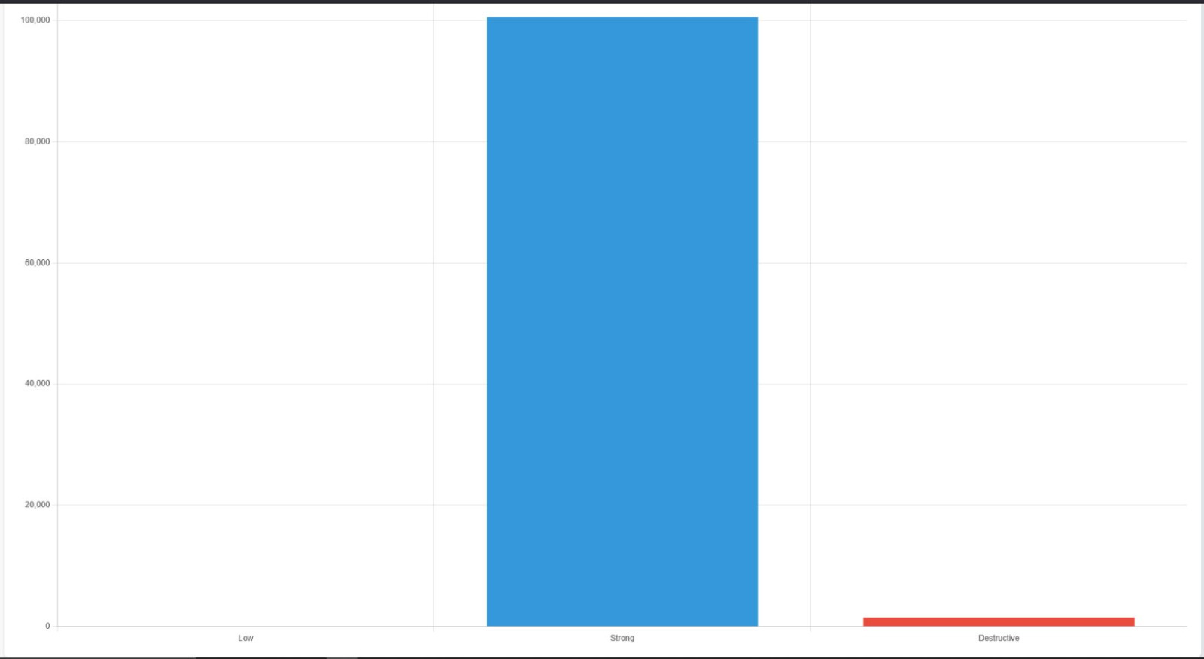
Visualizations: Bar graph
Shows the distribution of earthquakes categorized by magnitude, emphasizing the prevalence of strong but non-destructive events.

Slide 11

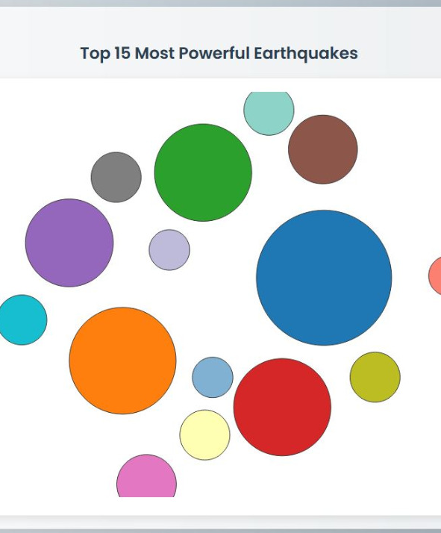
Visualizations: Bubble chart
Visualizes the top 15 strongest earthquakes, where bubble size reflects magnitude, offering a clear comparison of extreme seismic events.

Slide 12
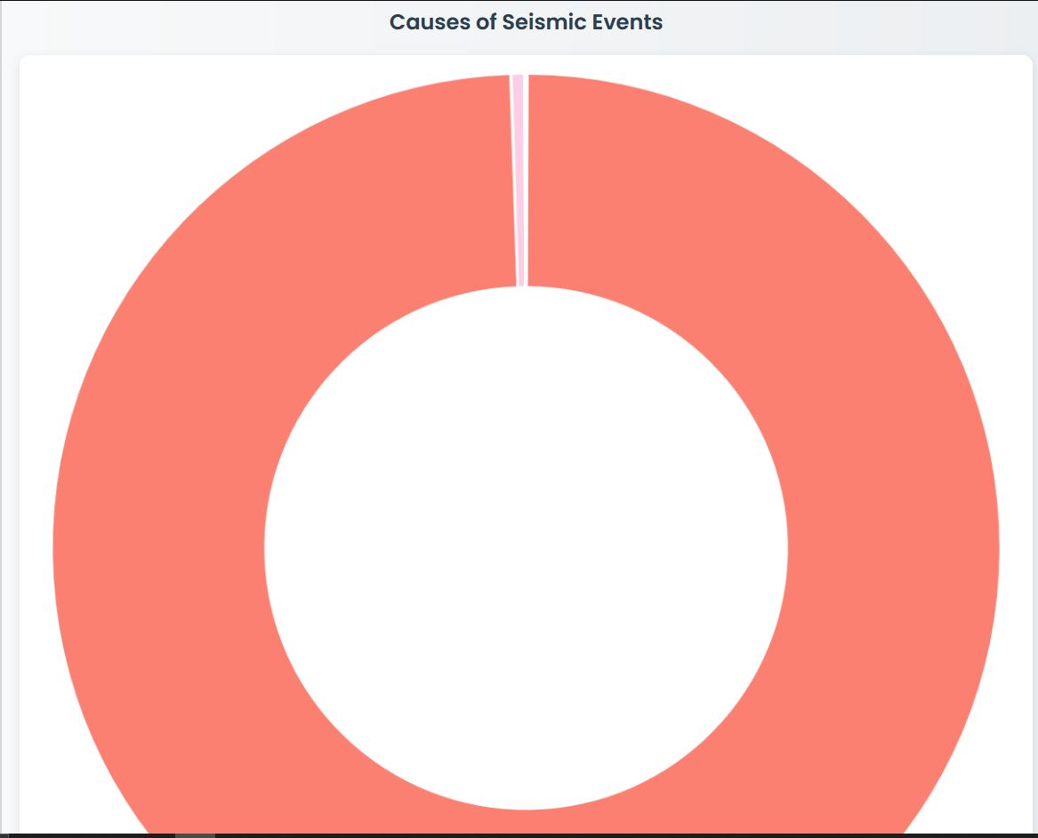
Visualizations: donut chart (Breakdown of seismic event causes)
Breaks down seismic events by cause, illustrating the dominance of natural earthquakes over human-induced seismic activities

Slide 13
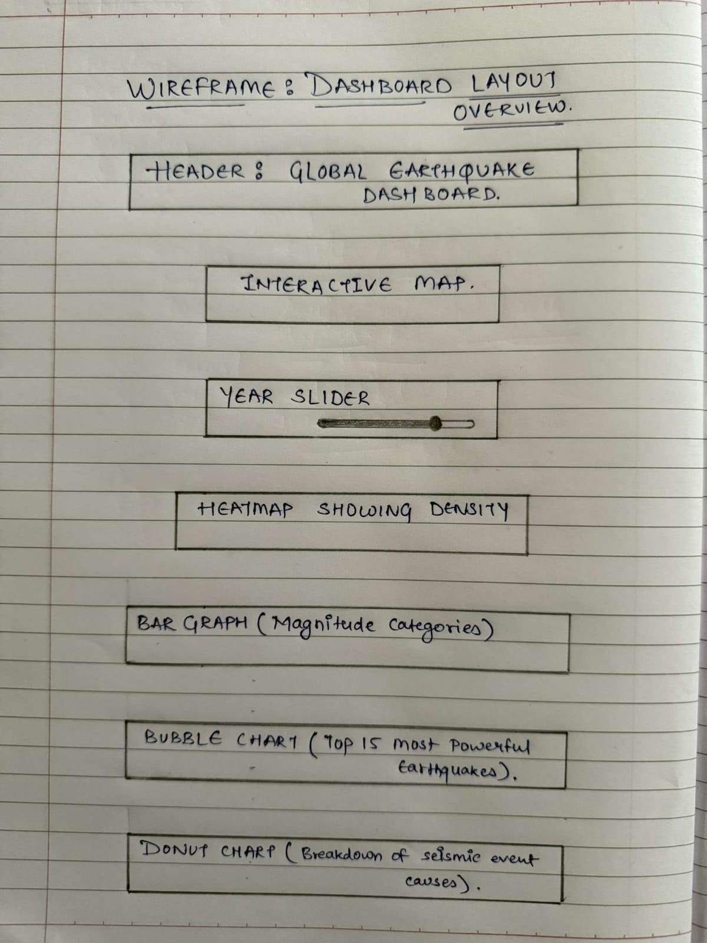
Wireframe Sketches

Slide 14
Conclusion & Future Scope
Conclusion:
- Successfully developed an interactive web-based dashboard for comprehensive seismic data analysis.
- Enabled users to explore global earthquake patterns through dynamic and intuitive visualizations.
Challenges Faced:
Handling large datasets required extensive Data cleaning and preprocessing.
complex visualizations.
Future Enhancements:
Integrated Real-time earthquake data
predictive analytics,
Enhance mobile responsiveness for broader accessibility across devices.

Slide 15


